Slide 1
Spectral Graph Approximation
Clemens Damke
Intelligent Systems and Machine Learning Group
ISML Seminar, July 2019

Slide 2
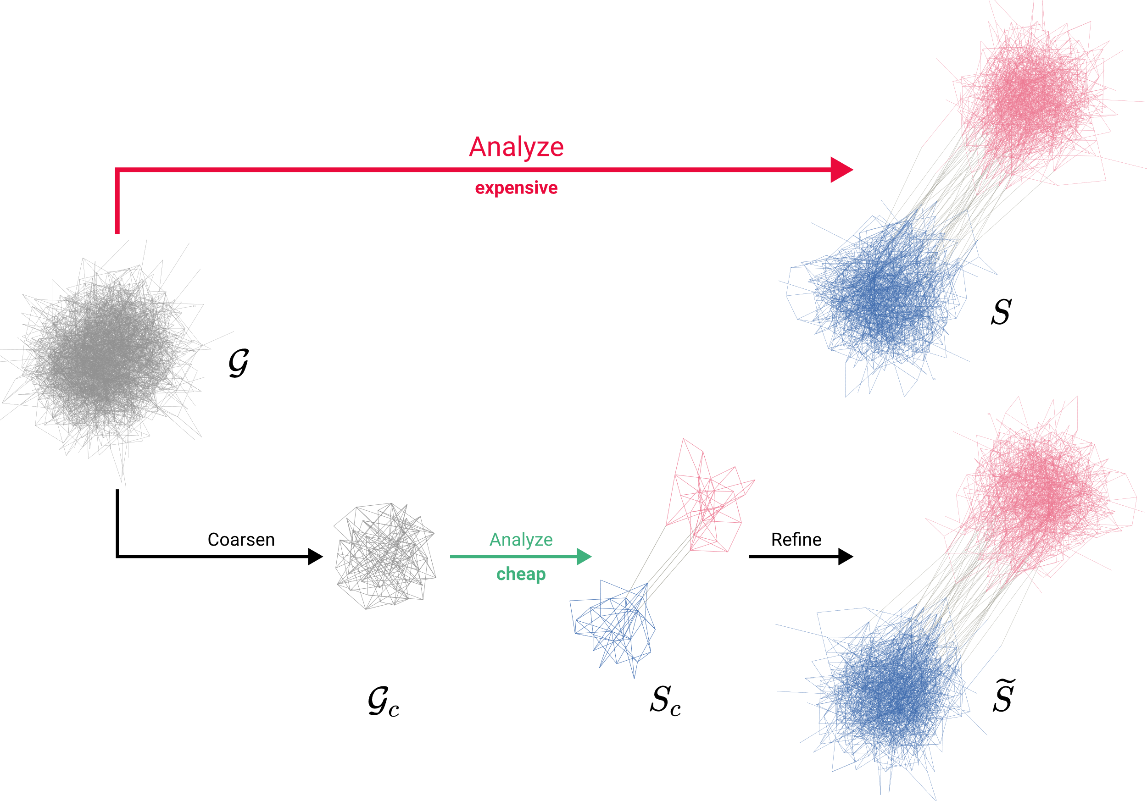
MOTIVATION

Slide 3
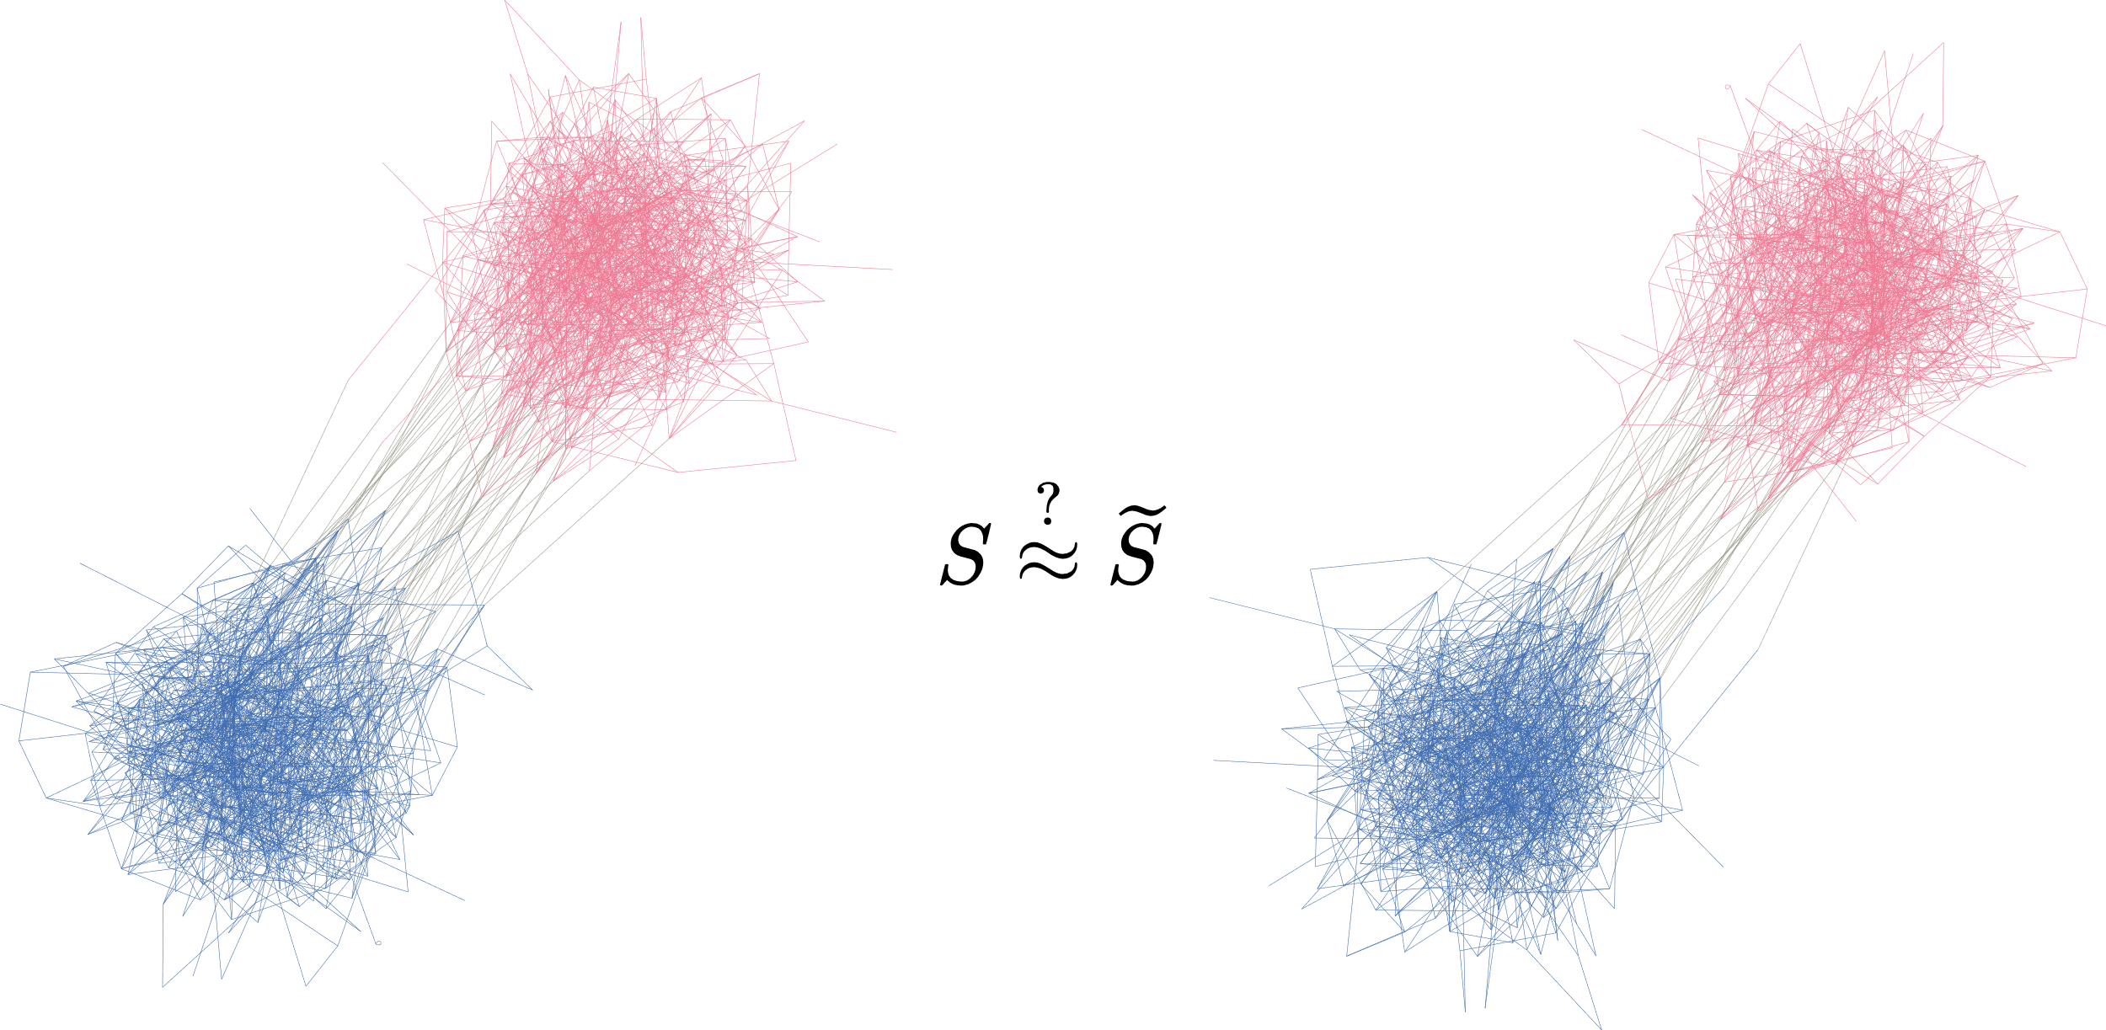
MOTIVATION
What is the effect of coarsening?

Slide 4
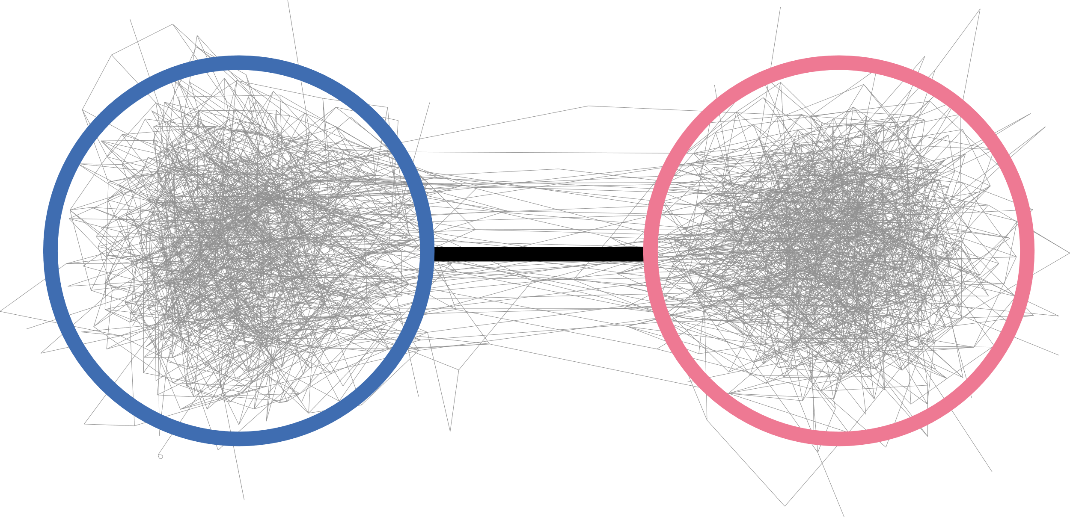
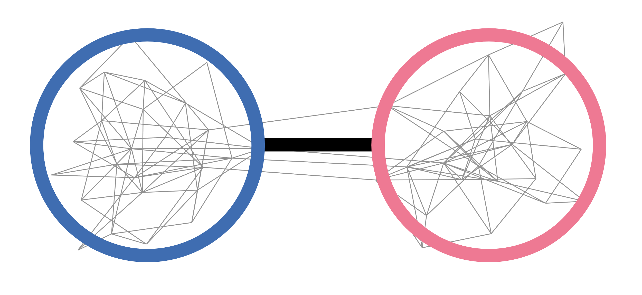
OVERVIEW
1. How to describe a graph‘s overall structure?
2. How to coarsen a graph?
3.
What is the effect of coarsening?

Slide 5
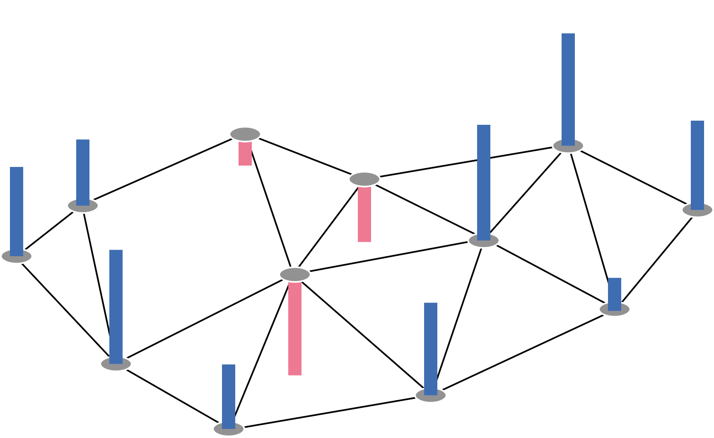
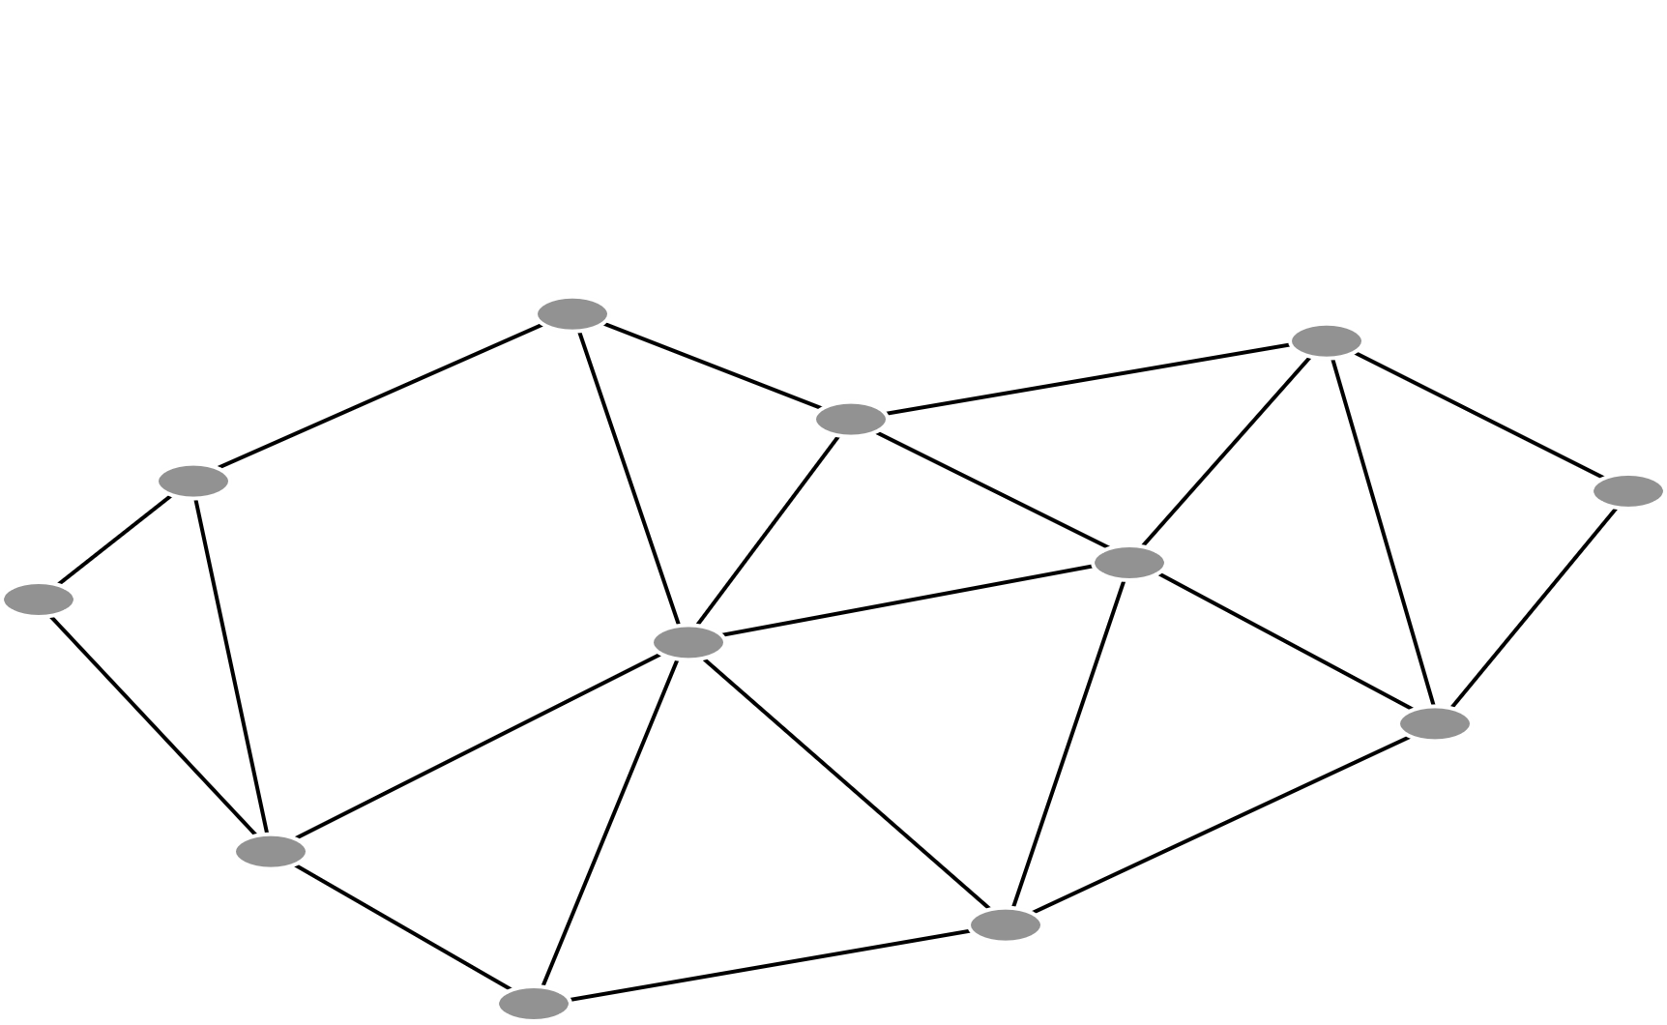
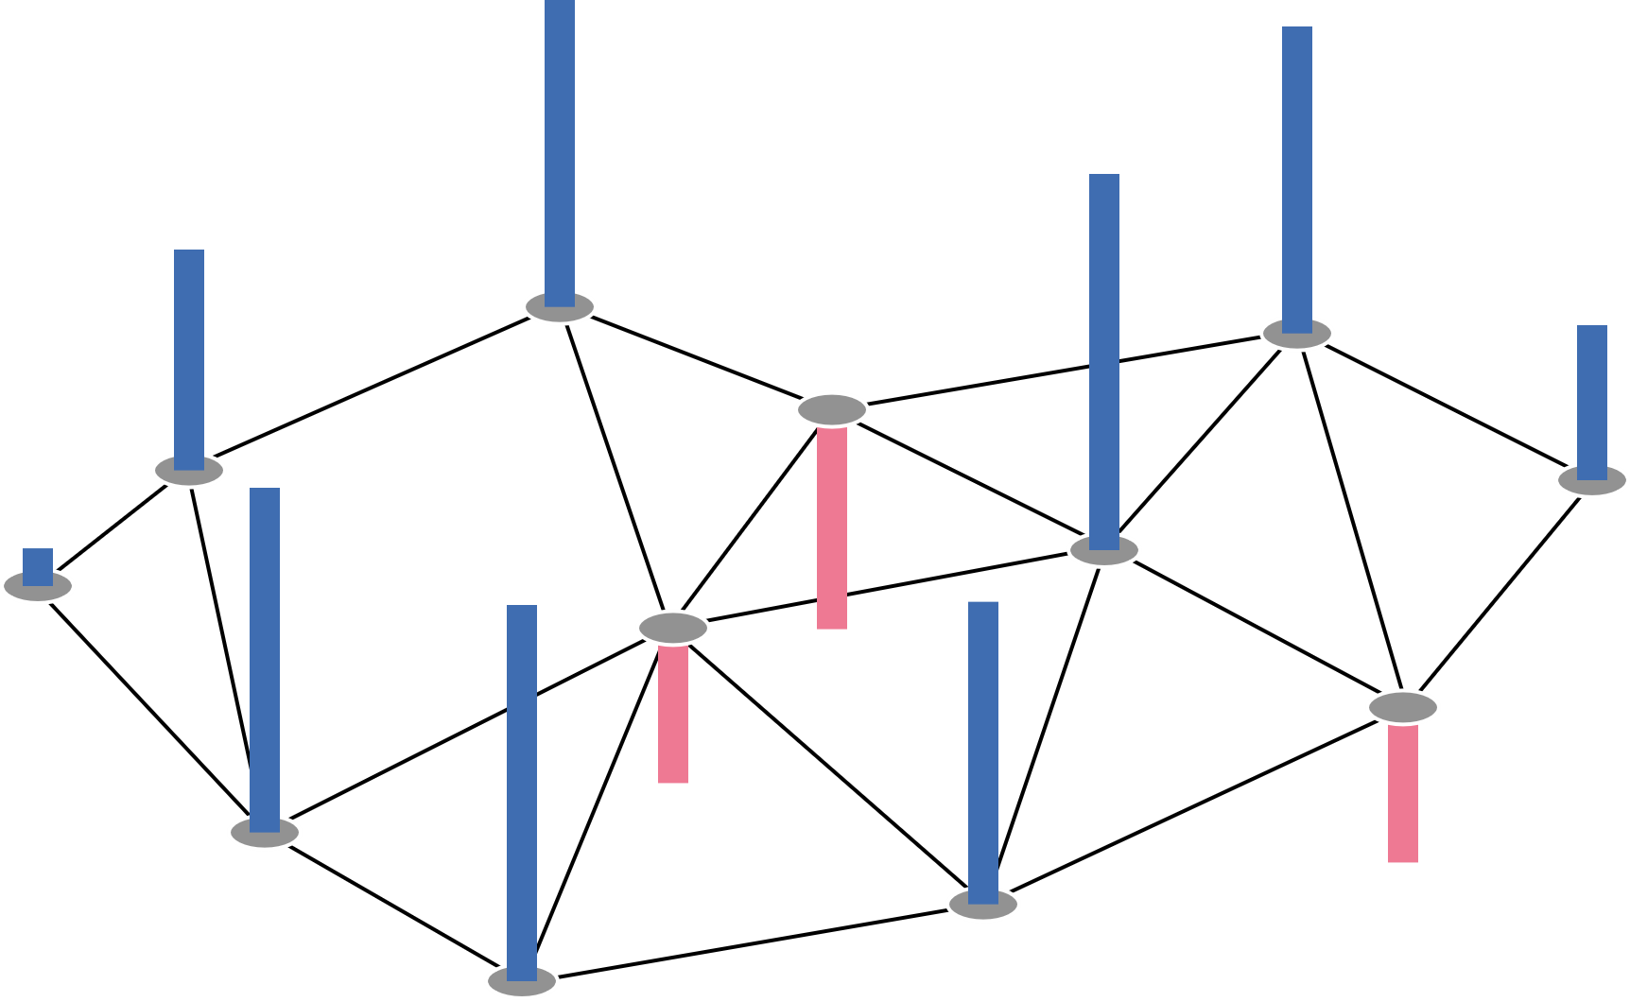
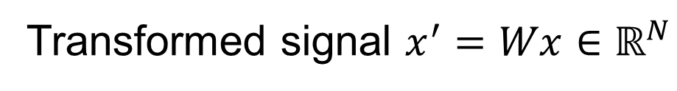
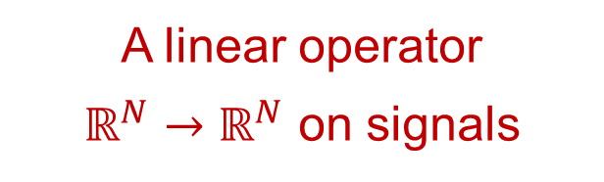
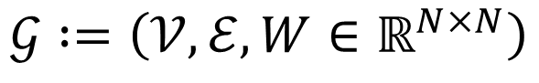
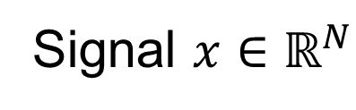
1. SPECTRAL GRAPH THEORY: Graphs as Linear Operators
$$𝒢 :=\left(𝒱, ℰ,W∈ℝ^{N×N}\right)$$
A linear operator
$ℝ^{N}→ℝ^{N}$ on signals
Transformed signal $x^{′}=Wx∈ℝ^{N}$
Signal $x∈ℝ^{N}$

Slide 6

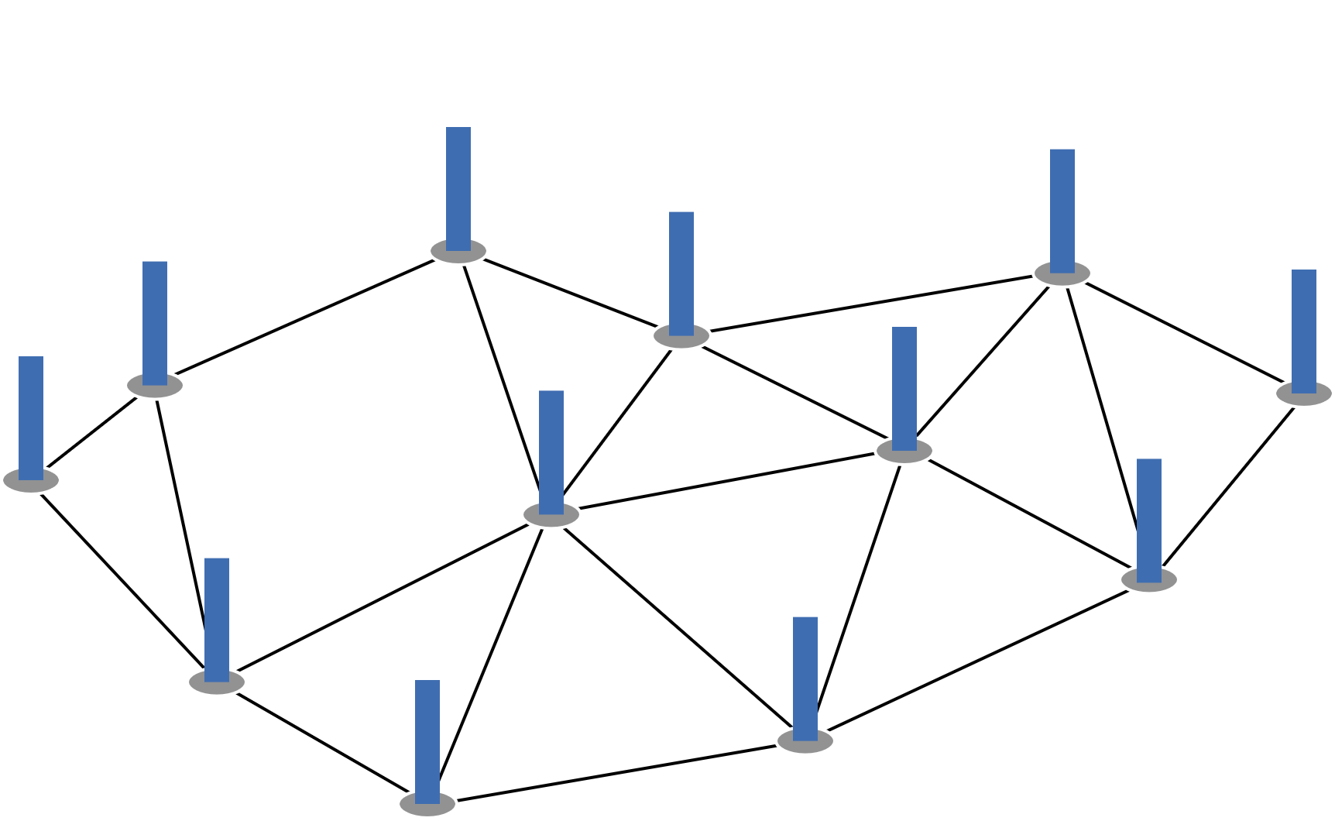
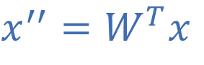
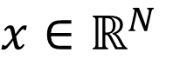
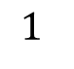
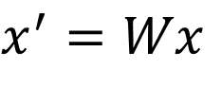
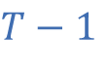
1. SPECTRAL GRAPH THEORY: Signals as Heat Distributions
Equilibrium
$$1$$
$$T−1$$
Heat Flow
$$x∈ℝ^{N}$$
$$x^{′}=Wx$$
$$x^{′′}=W^{T}x$$
Described by the Fourier Transform

Slide 7
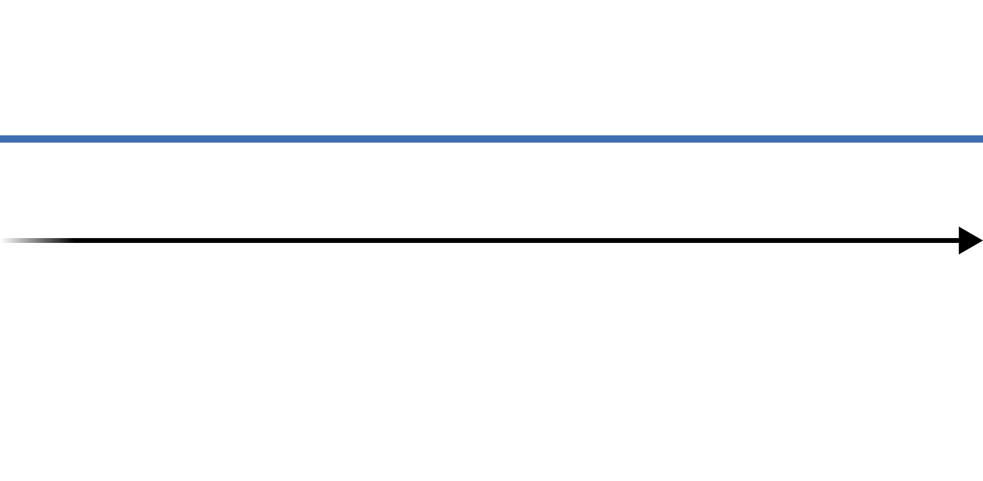
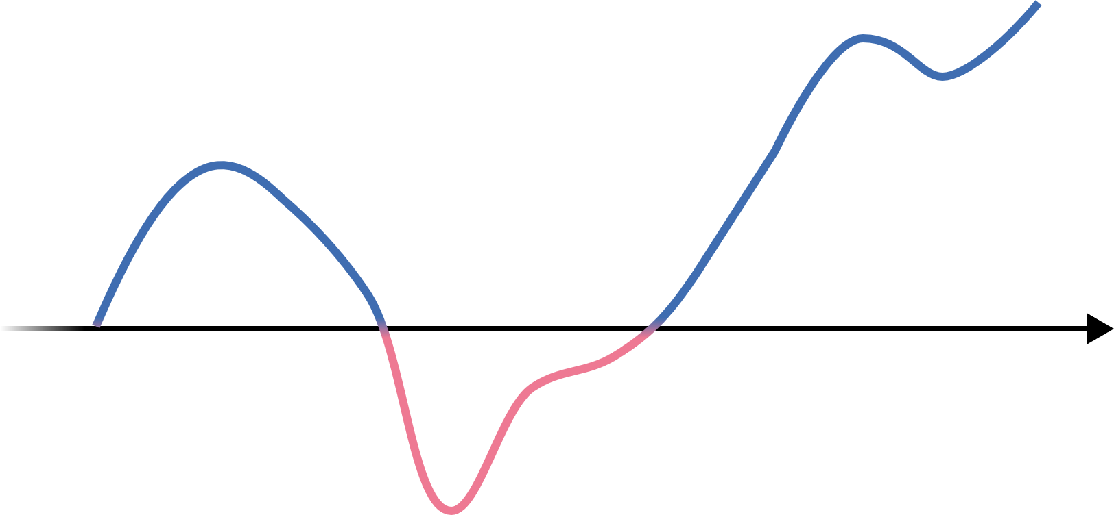
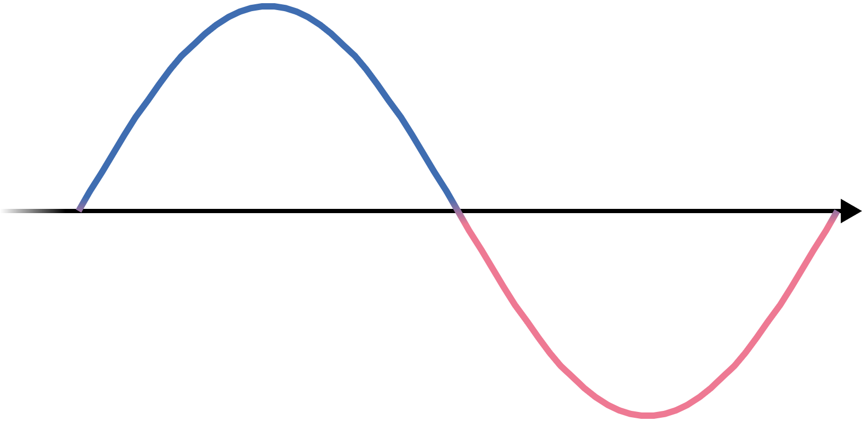
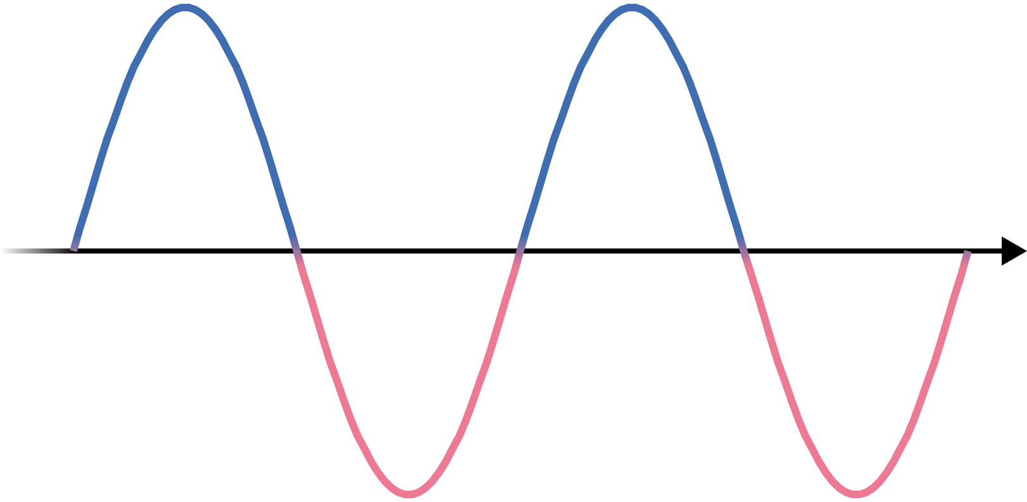
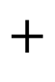
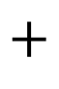
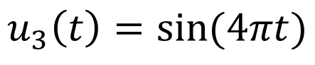
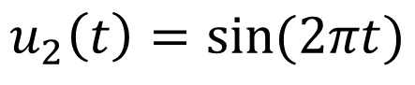
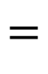
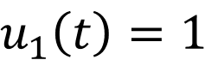
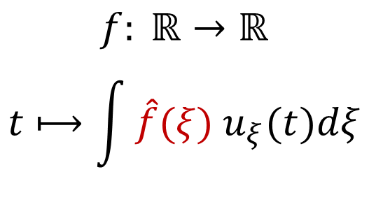
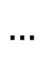
1. SPECTRAL GRAPH THEORY: The Classical Fourier Transform
$$u_{1}\left(t\right)=1$$
$$+$$
$$=$$
$$u_{2}\left(t\right)=sin⁡(2πt)$$
$$+$$
$$f: ℝ→ℝ$$
$$t⟼\int{\hat{f}(ξ){ u}_{ξ}(t)dξ}$$
$$u_{3}\left(t\right)=sin⁡(4πt)$$
$$…$$

Slide 8
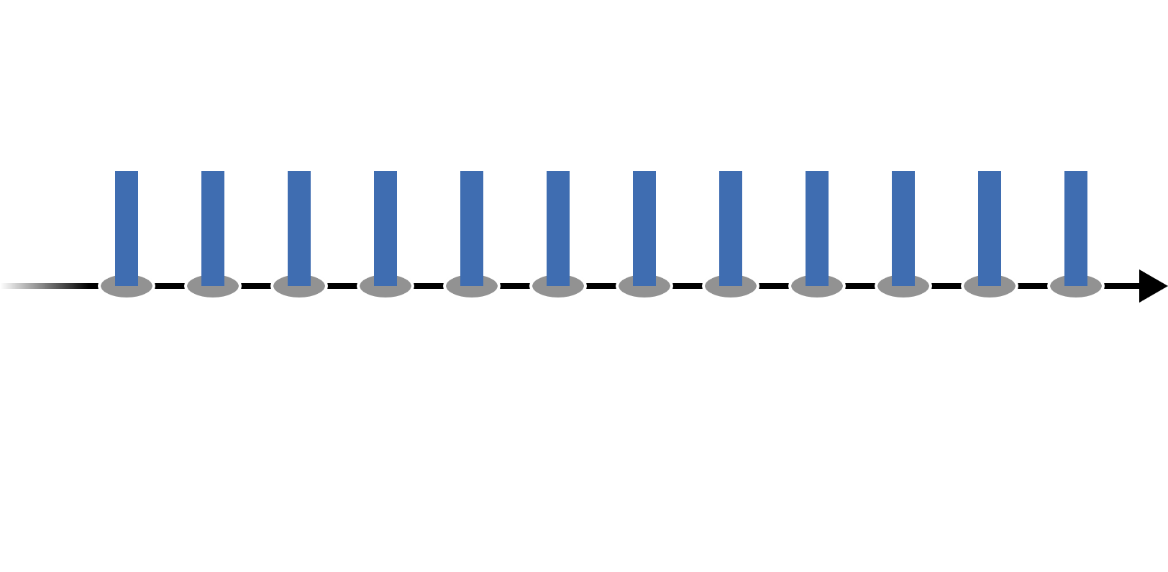
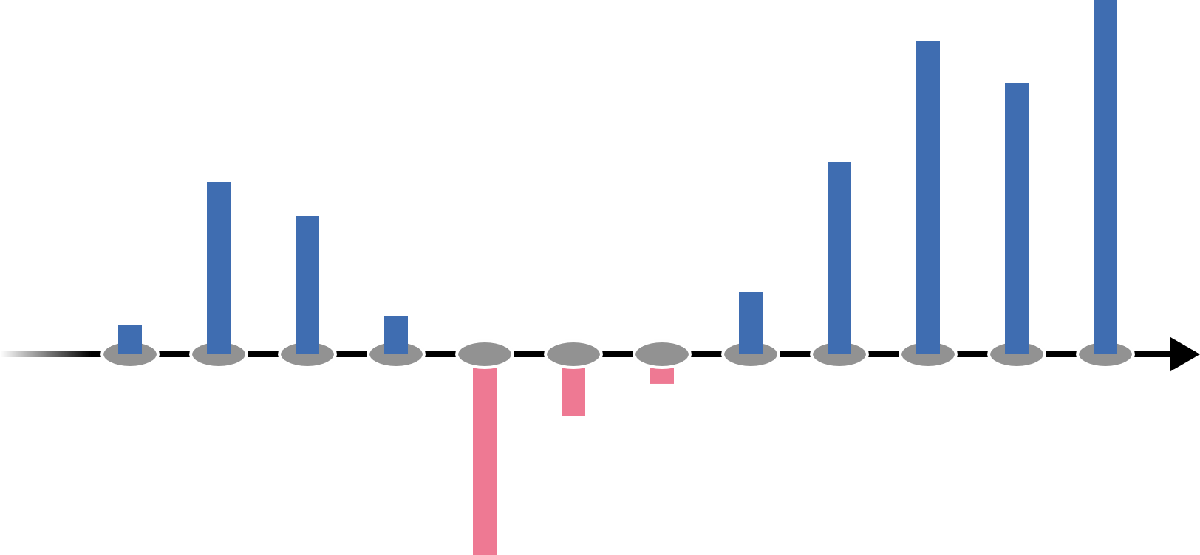
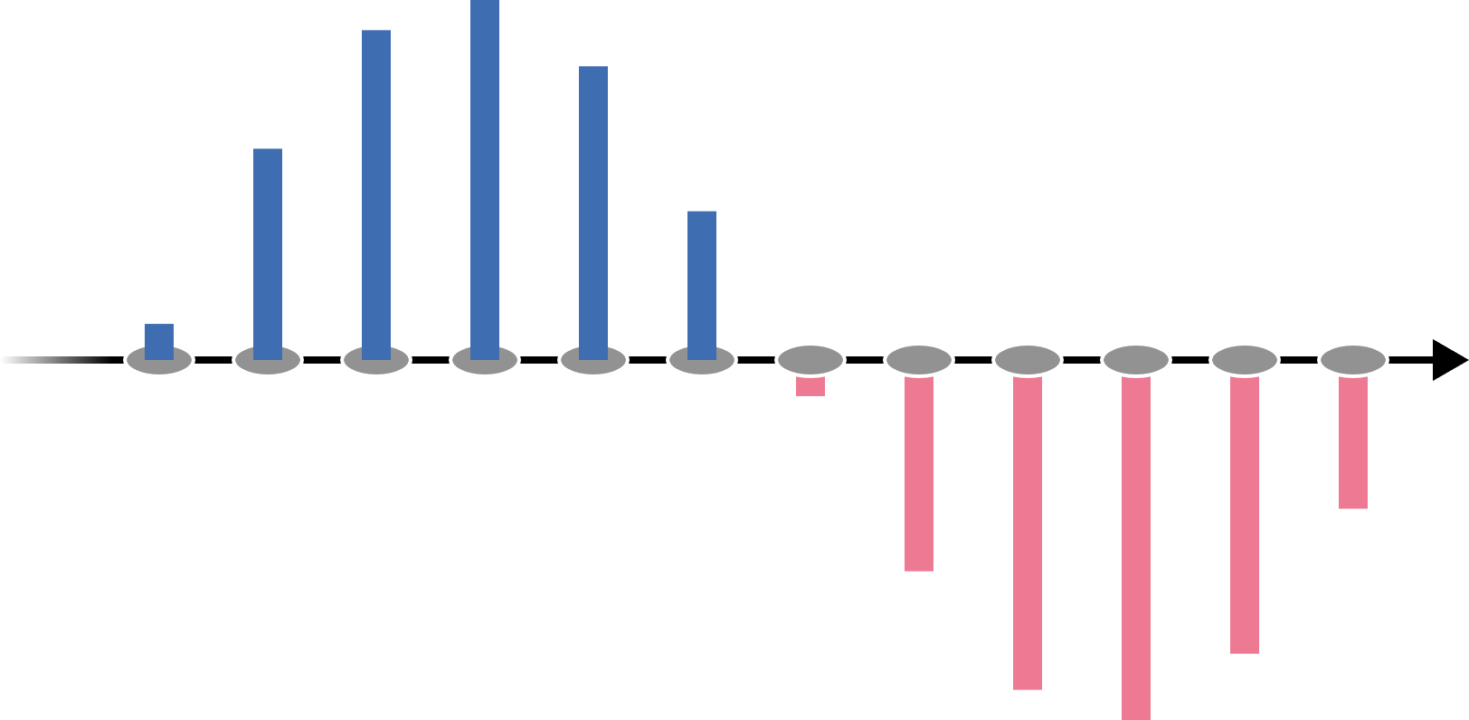
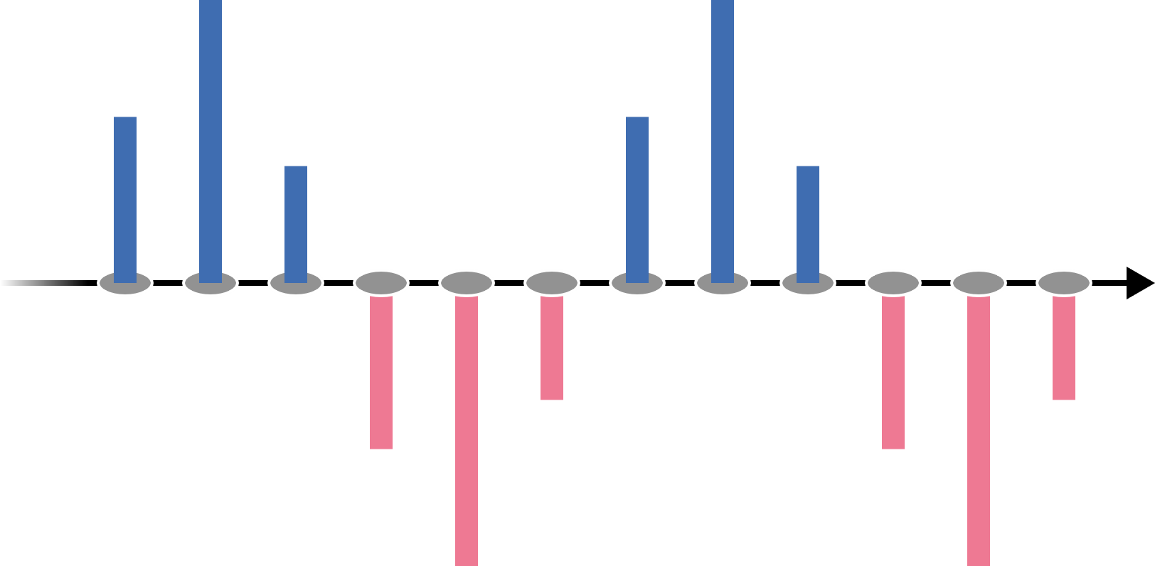
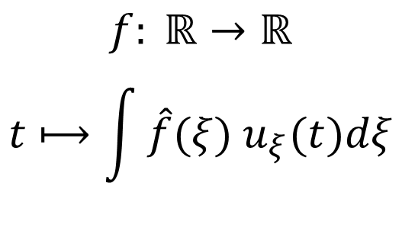
1. SPECTRAL GRAPH THEORY: Real-valued Functions as Graph Signals
$$u_{1}\left(t\right)=1$$
$$+$$
$$=$$
$$u_{2}\left(t\right)=sin⁡(2πt)$$
$$+$$
$$f: ℝ→ℝ$$
$$t⟼\int{\hat{f}(ξ){ u}_{ξ}(t)dξ}$$
$$u_{3}\left(t\right)=sin⁡(4πt)$$
How to generalize for arbitrary graphs?
$$…$$

Slide 9
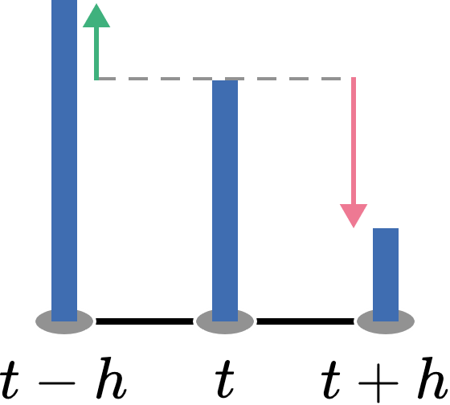
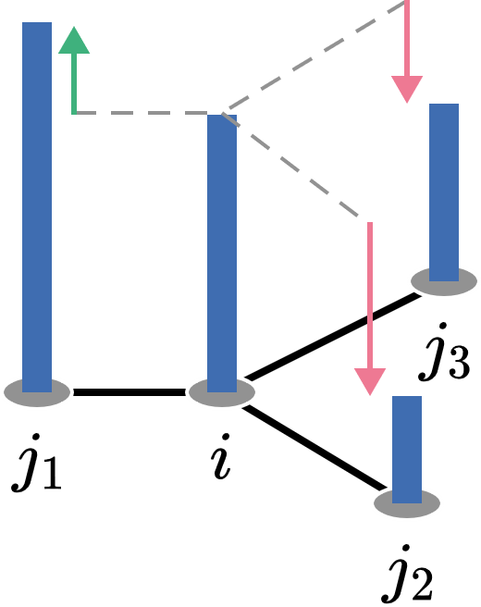

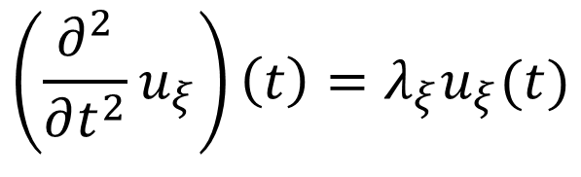
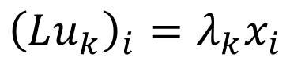
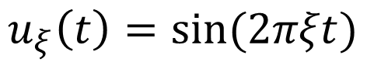
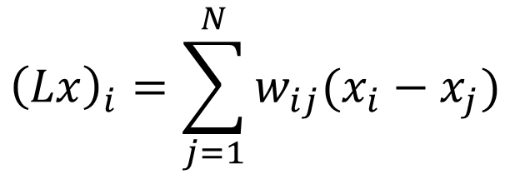
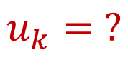
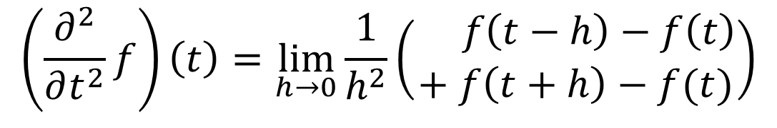
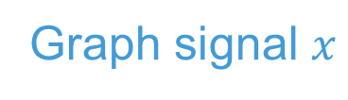
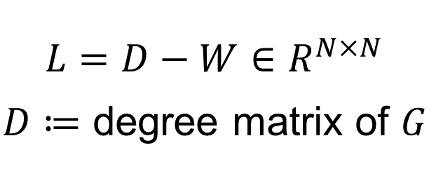
1. SPECTRAL GRAPH THEORY: The Graph Laplacian
Real-valued function $f$
Graph signal $x$
$$L=D−W∈R^{N×N}$$
$D≔$ degree matrix of $G$
$${\left(Lx\right)}_{i}=\sum_{j=1}^{N}{w_{ij}(x_{i}−x_{j})}$$
$$\left(\frac{∂^{2}}{∂t^{2}}f\right)\left(t\right)=\lim_{h→0}{\frac{1}{h^{2}}\left(\begin{aligned} f\left(t−h\right)−f\left(t\right) \\ + f\left(t+h\right)−f(t)\end{aligned}\right)}$$
$$\left(\frac{∂^{2}}{∂t^{2}}u_{ξ}\right)\left(t\right)=λ_{ξ}u_{ξ}(t)$$
$${\left(Lu_{k}\right)}_{i}=λ_{k}x_{i}$$
$$u_{ξ}\left(t\right)=sin⁡(2πξt)$$
$$u_{k}= ?$$

Slide 10
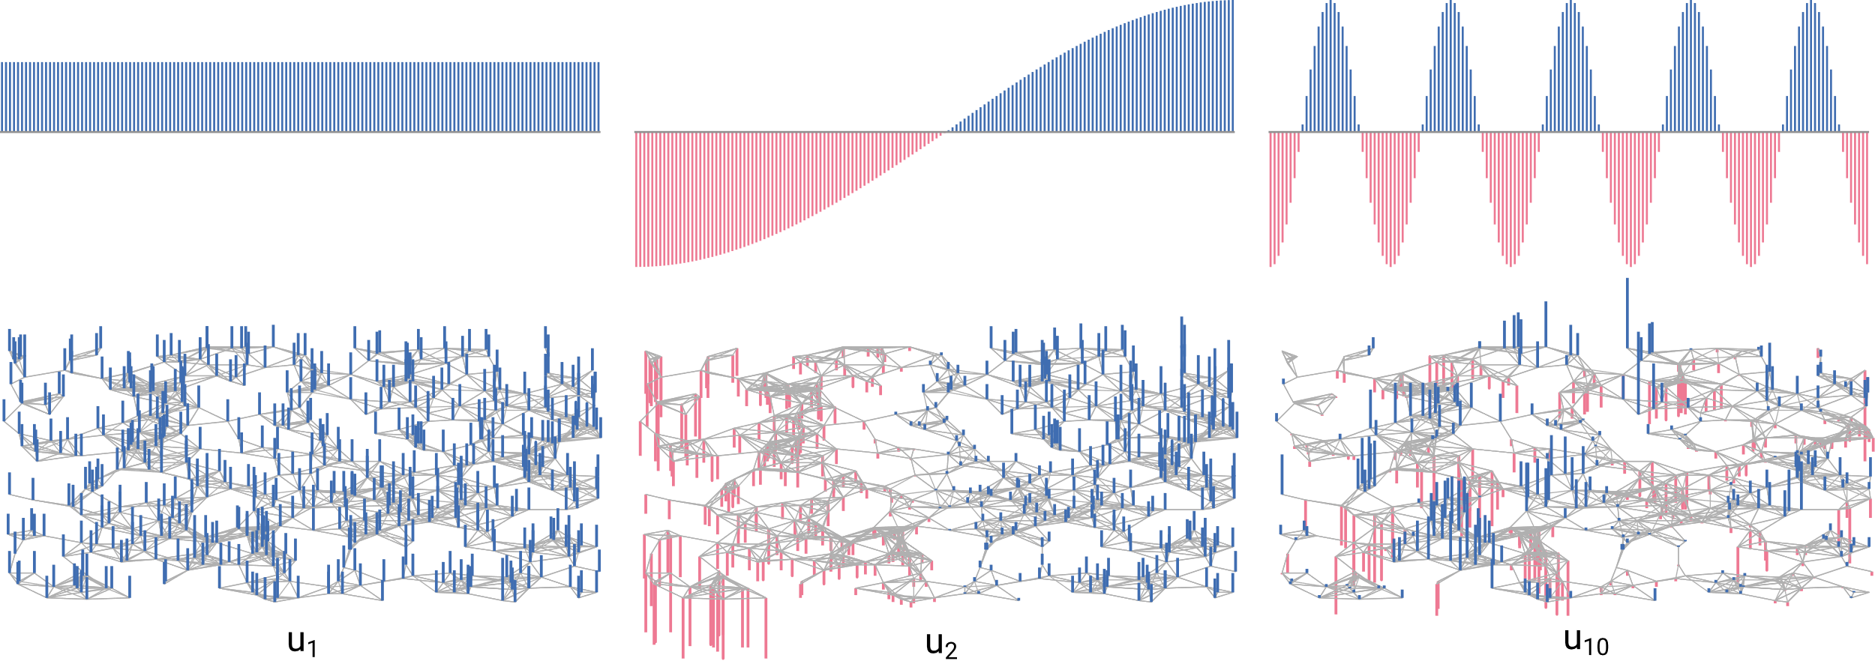
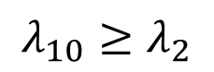
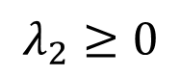
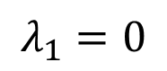
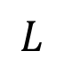
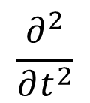
1. SPECTRAL GRAPH THEORY: Laplacian Eigenvectors
$$\frac{∂^{2}}{∂t^{2}}$$
$$L$$
Graph Spectrum:
$$λ_{1}=0$$
$$λ_{2}≥0$$
$$λ_{10}≥λ_{2}$$

Slide 11




1. SPECTRAL GRAPH THEORY: Interpretation of the Spectrum
$$λ_{2}>0$$
$$λ_{1}=0$$
Equilibrium
Equilibrium
$$λ_{2}=0$$
$⇒$ The spectrum describes graph connectivity

Slide 12
OVERVIEW
1. Spectral Graph Theory
2. How to coarsen a graph?
3.
What is the effect of coarsening?

Slide 13

2. GRAPH COARSENING
Objectives:
Reduce vertex count
Preserve structure

Slide 14


2. GRAPH COARSENING: Edge Contractions
Coarsening is described by a sequence of edge contractions

Slide 15







2. GRAPH COARSENING: Example
Original $G$
$$⇓$$
$$L$$
Coarsened $G_{c}$
$$⇓$$
$$L_{c}$$
Approximated $\tilde{G}$
$$⇓$$
$$\tilde{L}$$
$$≈$$

Slide 16




2. GRAPH COARSENING: Randomized Edge Contraction (REC)
$$∈\left[0, \frac{1}{2}\right]$$
Reduction ratio
Until $rN$ vertices are removed via contraction:
Select some $e_{ij}∈ℰ$ with probability $p_{ij}=\frac{w_{ij}}{\sum_{e_{kl}∈ℰ}{w_{kl}}}$
Contract $e_{ij}$
Only edges in the original graph are contracted
$⇒$ Each vertex is only contracted once

Slide 17



2. GRAPH COARSENING: REC Example (2 applications)
$G$: 500 vertices
$G_{c}$: 215 vertices
Source: A. Loukas

Slide 18
OVERVIEW
1. Spectral Graph Theory
2. REC Coarsening
3.
What is the effect of coarsening?

Slide 19




3. EFFECTS OF COARSENING
$$?$$
$$≈$$
Original $L$
Approximated $\tilde{L}$

Slide 20




3. EFFECTS OF COARSENING: Restricted Spectral Similarity (RSS)
$\tilde{L}$ is an $ε$–approximation of $L$ wrt. $u_{k}$
$$∀k≤K: \left(1−ε\right) \underset{λ_{k}}{\underbrace{u_{k}^{⊤}Lu_{k}}}≤u_{k}^{⊤}\tilde{L}u_{k}≤\left(1+ε\right)\underset{λ_{k}}{\underbrace{u_{k}^{⊤}Lu_{k}}}$$
Level of “detail” of the comparison
Typically set to equal no. of clusters in $G$

Slide 21


3. EFFECTS OF COARSENING: An RSS-bound on REC
$$P\left(\tilde{L} \text{is} ε\text{−}\text{approx}\text{. }\text{of} L \text{wrt}\text{. }u_{k}\right)≥1−\frac{rν_{max}}{2εd_{avg}}\left(1+\frac{3−4λ_{k}}{ν_{min}}\right)$$
$$d_{avg}≔ \text{average} \text{weighted} \text{vertex} \text{degree}$$
$$ν_{min/max}≔\text{min}\text{/}\text{max} \text{neighborhood} \text{weight}$$

Slide 22



3. EFFECTS OF COARSENING: An RSS-bound on REC
$$P\left(\tilde{L} \text{is} ε\text{−}\text{approx}\text{. }\text{of} L \text{wrt}\text{. }u_{k}\right)≥1−\frac{rν_{max}}{2εd_{avg}}\left(1+\frac{3−4λ_{k}}{ν_{min}}\right)$$
High approximation error $ε$
$⇓$
High approximation probability
High reduction ratio $r$
$⇓$
Low approximation probability

Slide 23




3. EFFECTS OF COARSENING: An RSS-bound on REC
$$P\left(\tilde{L} \text{is} ε\text{−}\text{approx}\text{. }\text{of} L \text{wrt}\text{. }u_{k}\right)≥1−\frac{rν_{max}}{2εd_{avg}}\left(1+\frac{3−4λ_{k}}{ν_{min}}\right)$$
$∀λ_{k}≤\frac{ν_{min}}{4}$ :
Large eigenvalue $λ_{k}$
$⇓$
High approximation probability

Slide 24




3. EFFECTS OF COARSENING: An RSS-bound on REC
$$P\left(\tilde{L} \text{is} ε\text{−}\text{approx}\text{. }\text{of} L \text{wrt}\text{. }u_{k}\right)≥1−\frac{rν_{max}}{2εd_{avg}}\left(1+\frac{3−4λ_{k}}{ν_{min}}\right)$$
$∀λ_{k}≤\frac{ν_{min}}{4}$ :
High irregularity $⇒$ Low approximation probability

Slide 25

3. EFFECTS OF COARSENING: An RSS-bound on REC
$$P\left(\tilde{L} \text{is} ε\text{−}\text{approx}\text{. }\text{of} L \text{wrt}\text{. }u_{k}\right)≥1−\frac{rν_{max}}{2εd_{avg}}\left(1+\frac{3−4λ_{k}}{ν_{min}}\right)$$
$∀λ_{k}≤\frac{ν_{min}}{4}$ :
Positive influences:
Negative influences:
+ Increased allowed error
+ Large eigenvalues (up to a certain point)
- Increased reduction ratio
- Graph irregularity

Slide 26


3. EFFECTS OF COARSENING: Implications for Spectral Clustering
$$P\left(\tilde{L} \text{is} ε\text{−}\text{approx}\text{. }\text{of} L \text{wrt}\text{. }u_{k}\right)≥1−\frac{rν_{max}}{2εd_{avg}}\left(1+\frac{3−4λ_{k}}{ν_{min}}\right)$$
$∀λ_{k}≤\frac{ν_{min}}{4}$ :

Slide 27

RECAP
$$≈$$
1. Spectral Graph Theory
2. REC Coarsening
3. RSS-bound on REC

Slide 28



RECAP
Spectral Graph Theory
REC Coarsening
RSS-bound on REC

Slide 29
Thank you!

